Slide 1
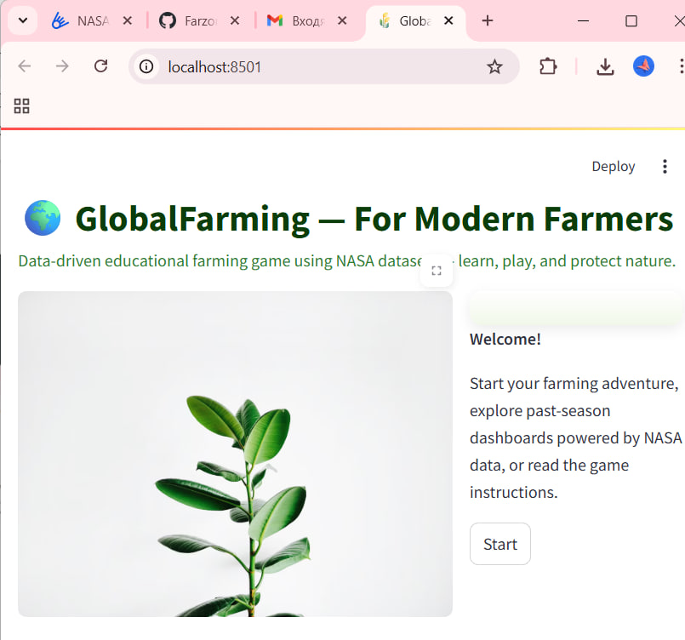
A New Era of Data-Driven Farming
Simulation Game
Real-World Data
Designed to make agriculture smarter, more sustainable, and data-driven.
Uses NASA Earth observation datasets for realistic farming conditions.
Global Reach
Recreates diverse farming scenarios across various regions worldwide.

Slide 2
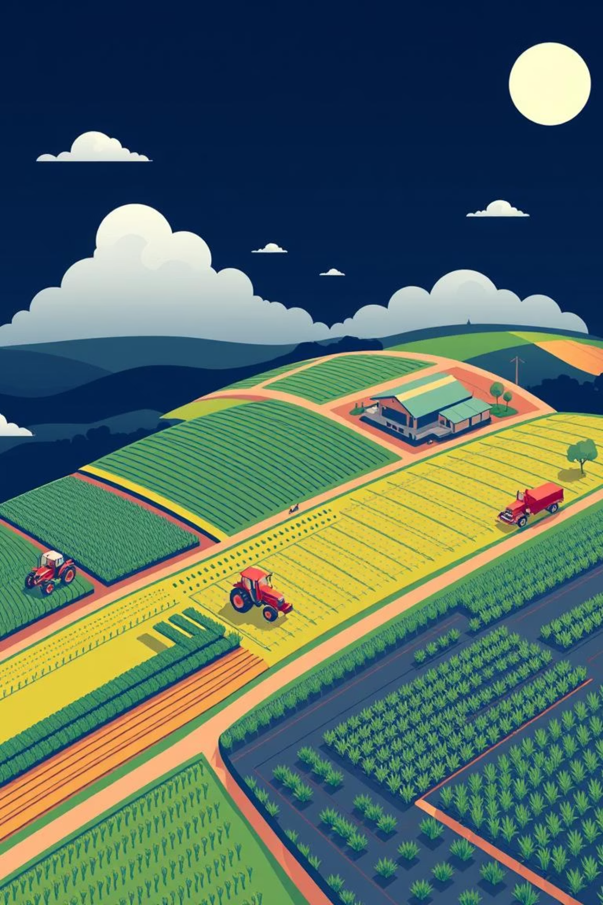
SmartFarm: Cultivating the Future of Agriculture
SmartFarm is an innovative simulation game revolutionizing how we understand and engage with sustainable agriculture. It transforms complex data into an engaging experience, inspiring a new generation of farmers and policymakers.

Slide 3
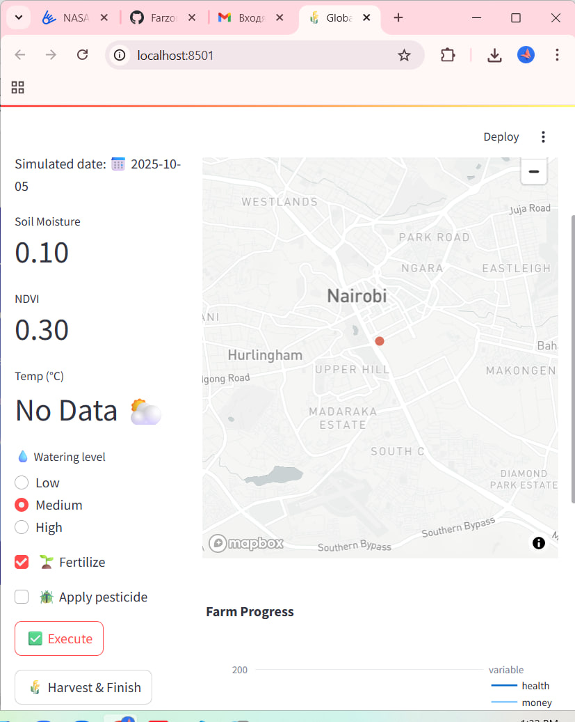
Your Farming Journey Begins
Players embark on their agricultural adventure by making strategic choices that set the stage for their farm's success.
Choose Your Location: Select from diverse global regions, each with unique climate and soil characteristics.
Select Your Crop: Opt for crops best suited to your chosen environment and market demand.
Plan Your Farm: Decide on the optimal land area to cultivate, balancing resources and potential yield.

Slide 4
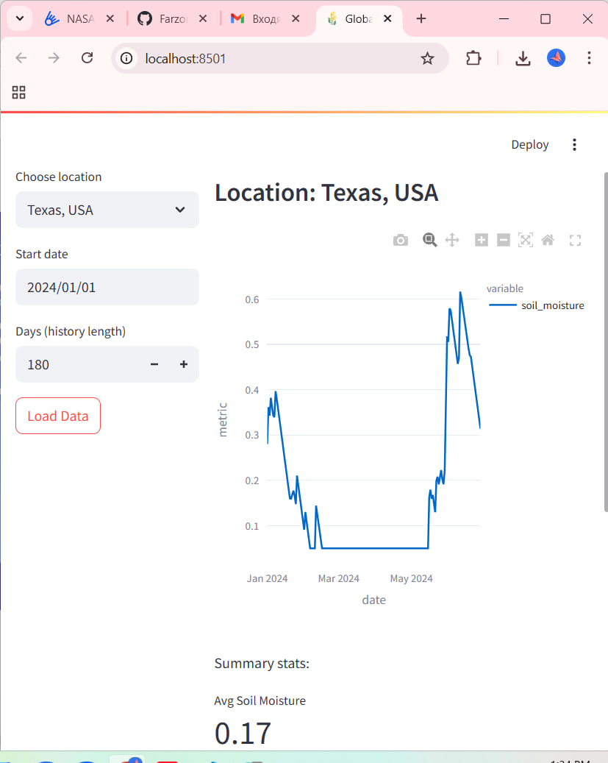
Balancing Productivity and Sustainability
SmartFarm's advanced simulation engine, powered by NASA data models, calculates the multifaceted outcomes of player decisions.
Profitability: Track financial gains based on yields and market prices.
Resource Usage: Monitor water, energy, and nutrient consumption.
Ecological Impact: Understand how farming practices affect the environment.
This holistic approach highlights how smart farming can achieve both high productivity and nature conservation.

Slide 5
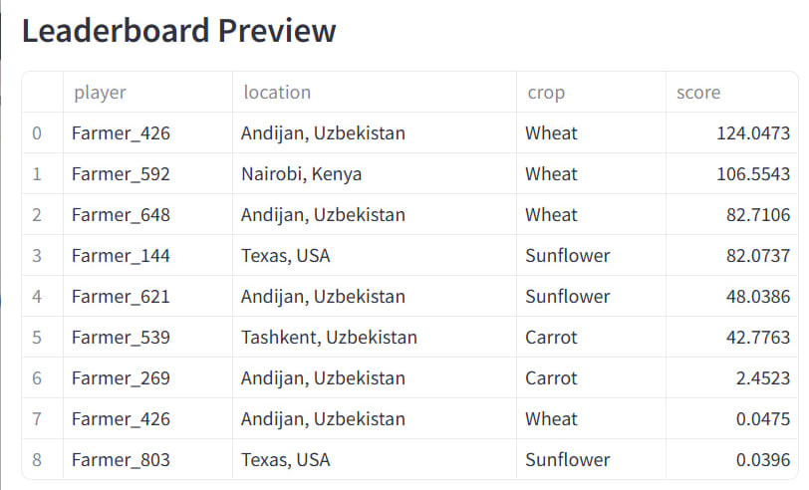


Rewarding Excellence: The Leaderboard
Best Farmer
Eco Guardian
Innovation Champion
Recognizing players with the highest overall profit.
Celebrating sustainable resource use and minimal environmental impact.
Awarding those who experiment with new techniques.
The leaderboard encourages healthy competition and diverse strategies, proving that success can come in many forms.

Slide 6


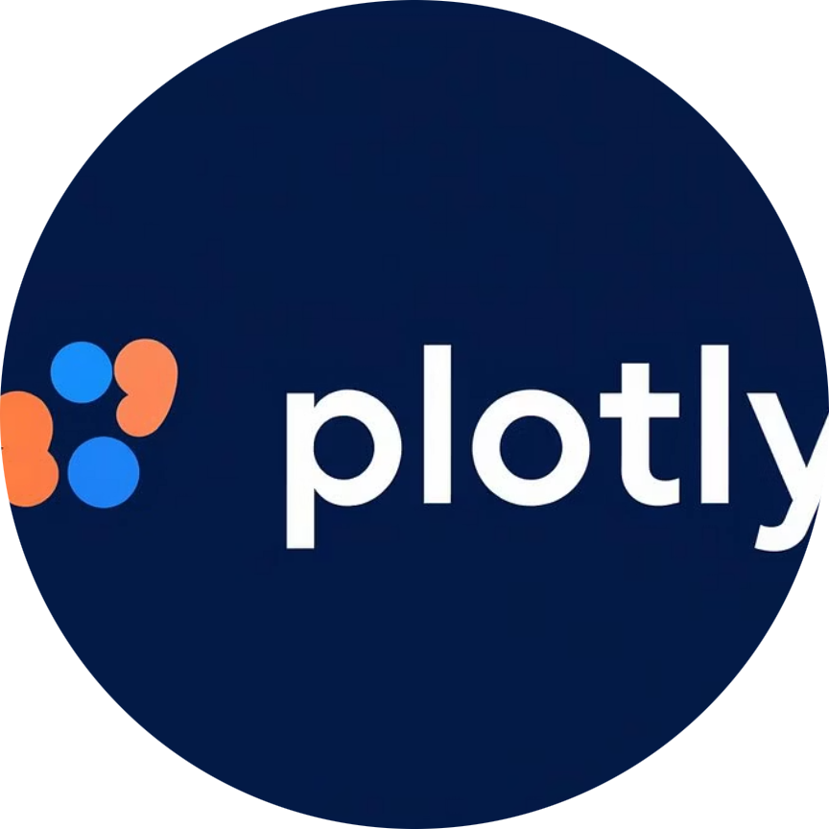
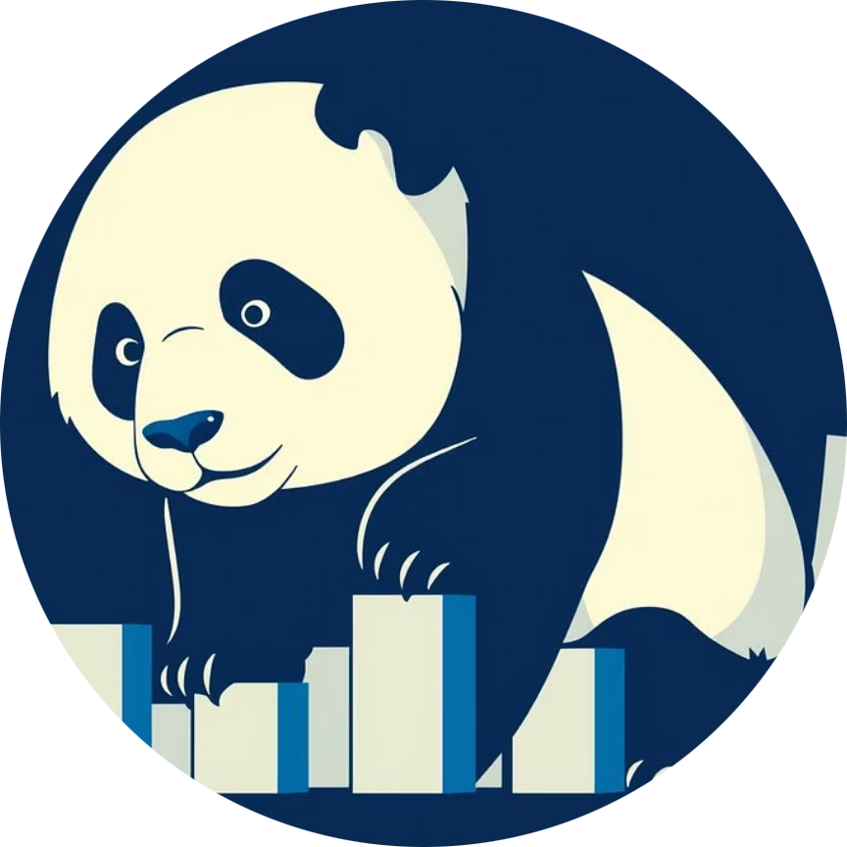

Technology Powering SmartFarm
Our platform leverages a robust tech stack to deliver a seamless and insightful experience.
Python
Streamlit
Plotly
Pandas
Backend logic and data processing.
Interactive and user-friendly interface (UI).
Dynamic data visualization and charting.
Efficient data manipulation and analysis.
NASA Datasets
Real-world environmental insights.

Slide 7
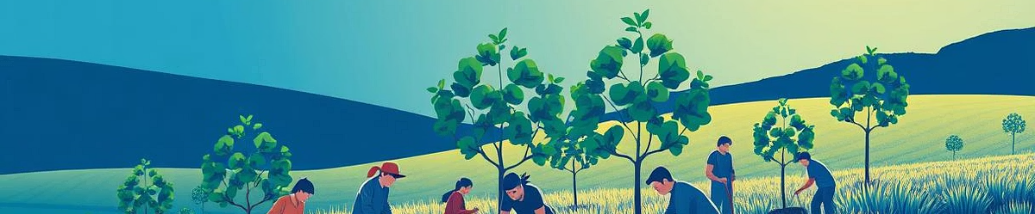
Growing Knowledge, Responsibility, and a Greener Future
"Through SmartFarm, we show that farming is not just about growing crops — it’s about growing knowledge, responsibility, and a greener future."
We invite future farmers, students, and policymakers to experience the power of data-driven decision-making and embrace the importance of sustainable agriculture. Join us in cultivating a better tomorrow!

